Slide 1
Fetal Health Classification
Link : - https://www.kaggle.com/andrewmvd/fetal-health-classification

Slide 2
My learning through this project :
Analysis of each and every column is very much important.
Abnormal outliers cause noise in the model, and the accuracy of the model is affected.
Principal Component Analysis (PCA) is very much useful in data dimension reduction.

Slide 3
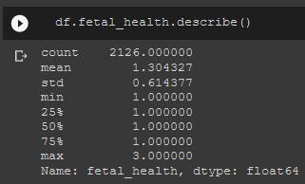
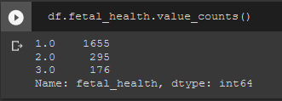
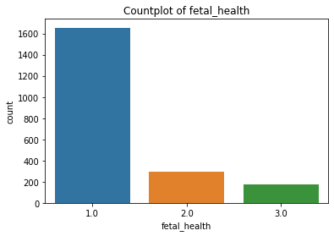
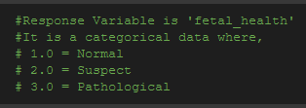
fetal health (Response Variable)
Count plot of fetal_health

Slide 4
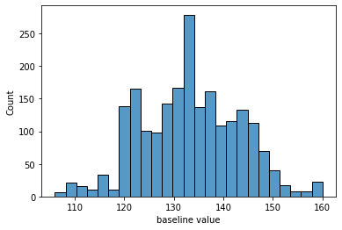
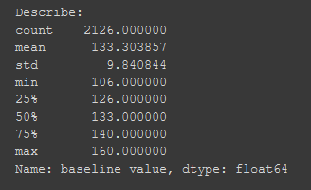
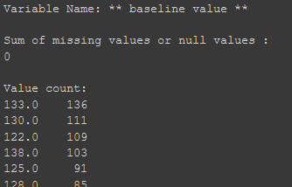
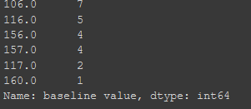
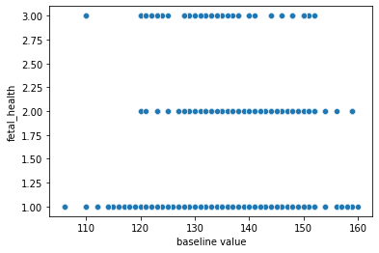
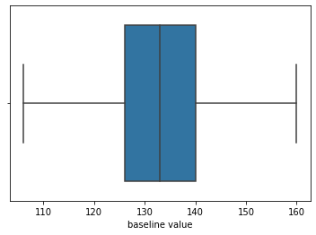
Baseline Value (Continuous Variable)
Histogram of baseline_value
Scatter plot of baseline_value
Boxplot of baseline_value

Slide 5
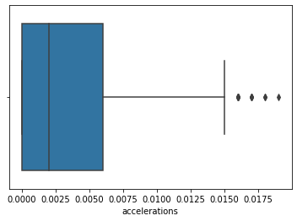
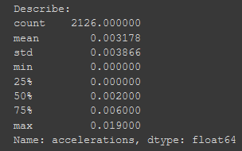
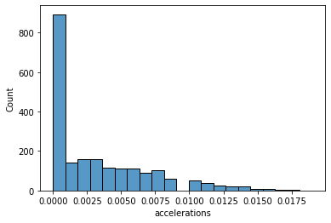
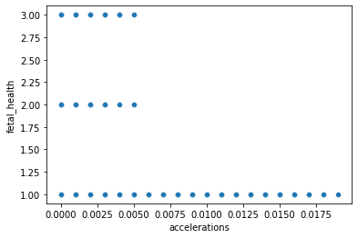
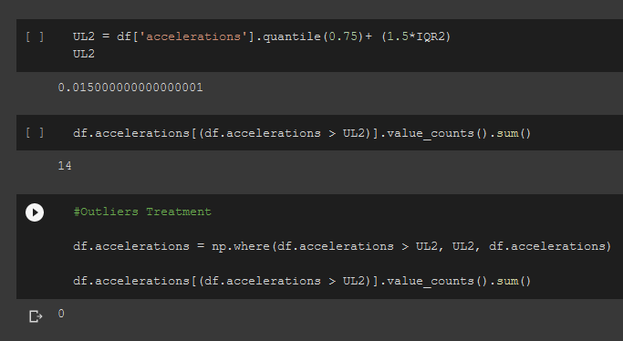
Accelerations (Continuous Variable)
Histogram of baseline_value
Boxplot of baseline_value
Scatter plot of baseline_value
Outliers treatment

Slide 6
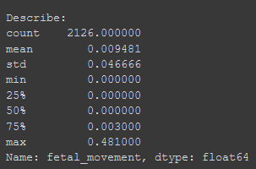
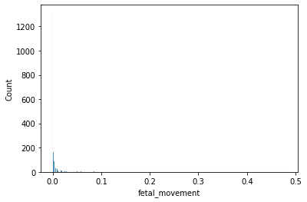
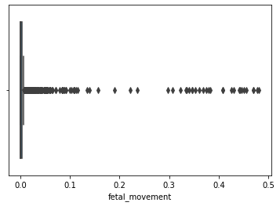
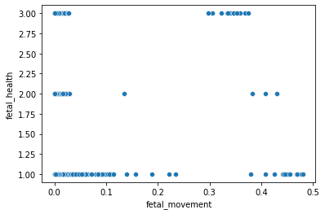
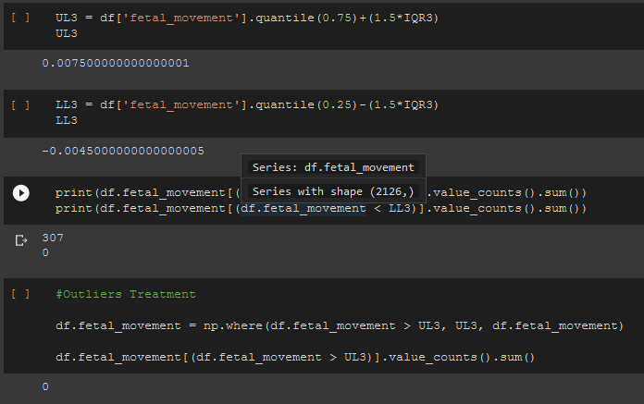
Fetal_Movement (Continuous Variable)
Histogram of Fetal_movement
Boxplot of Fetal_movement
Scatter plot of fetal_movement
Outliers treatment

Slide 7
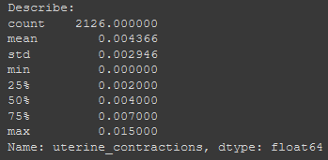
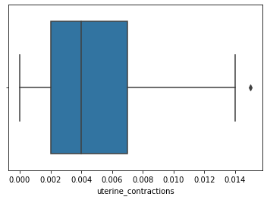
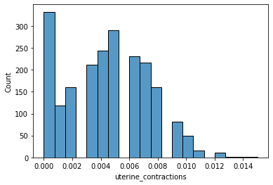
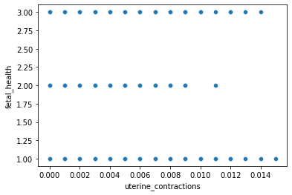
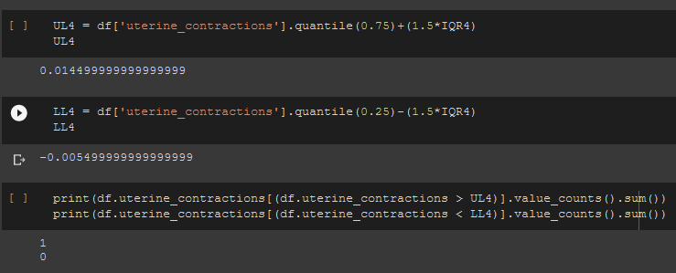
uterine_contractions (Continuous Variable)
Histogram of uterine_contractions
Boxplot of uterine_contractions
Scatter plot of uterine_contractions
Outliers treatment

Slide 8
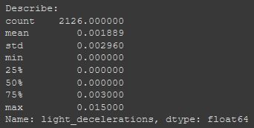
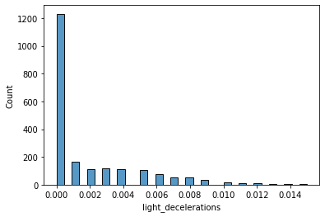
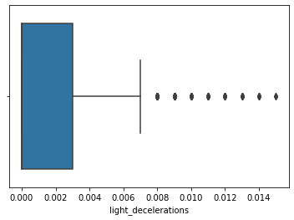
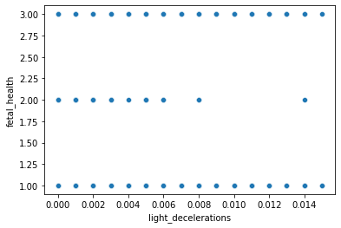
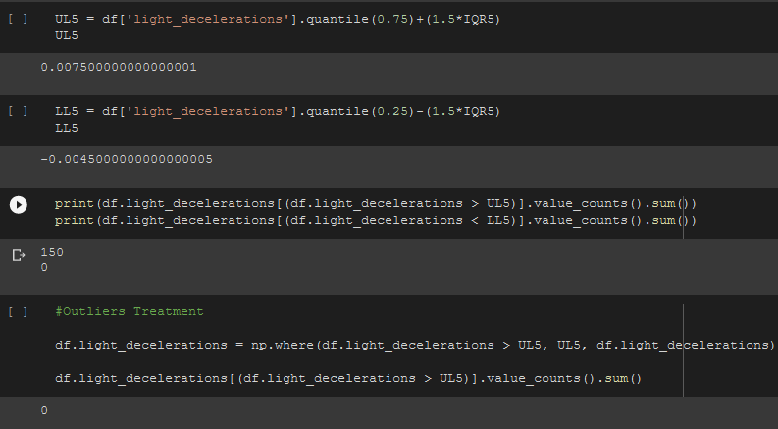
light_decelerations (Continuous Variable)
Histogram of light_decelerations
Boxplot of light_decelerations
Scatter plot of light_decelerations
Outliers treatment

Slide 9
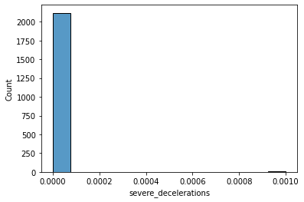
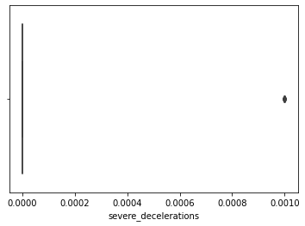
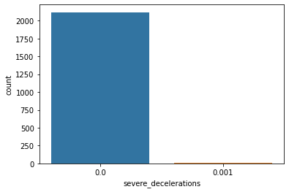
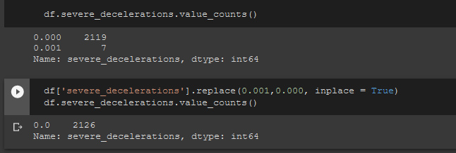

severe_decelerations (Continuous Variable)
Histogram of severe_decelerations
Boxplot of severe_decelerations
Count plot of severe_decelerations

Slide 10
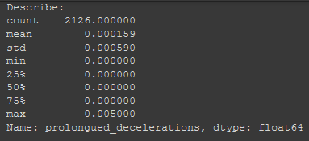
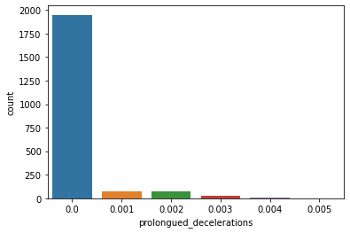
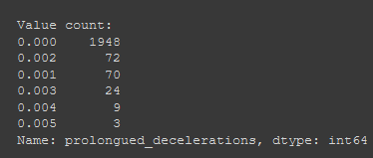
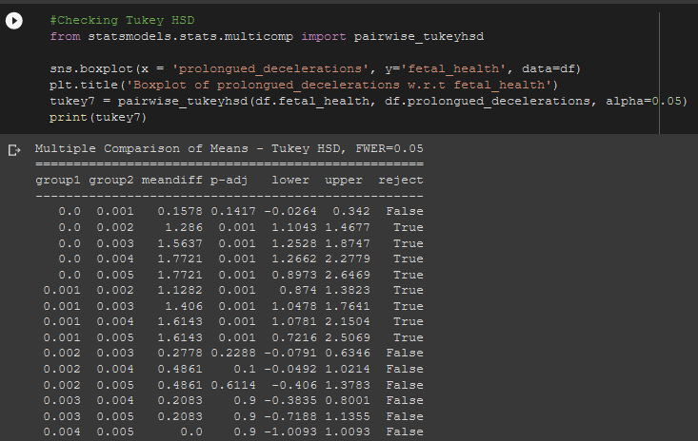
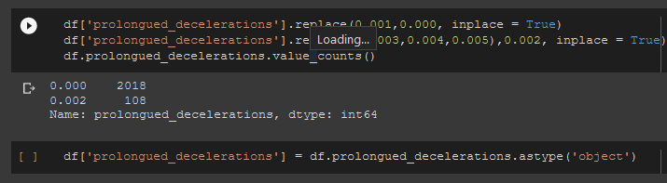
prolongued_decelerations (Categorical Variable)
Countplot of prolongued_decelerations
Tukey HSD – Category Minimization
Converted to categorical

Slide 11
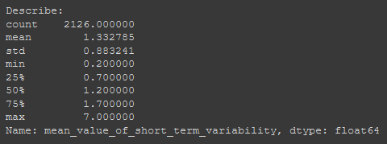
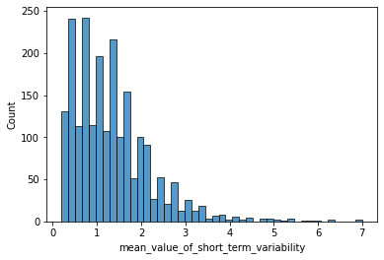
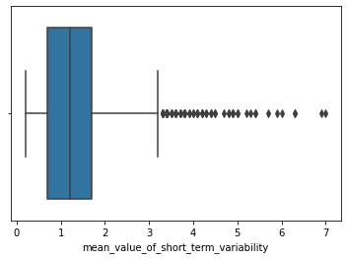
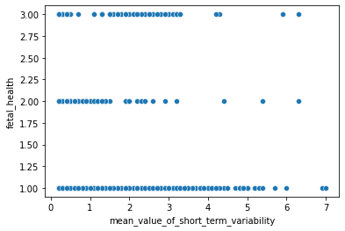
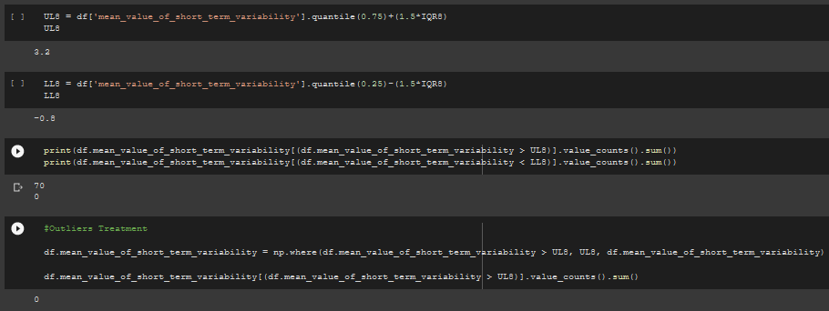
mean_value_of_short_term_variability
Histogram of mean_value_of_short_term_variability
Boxplot of mean_value_of_short_term_variability
Scatter plot of mean_value_of_short_term_variability
Outliers treatment

Slide 12
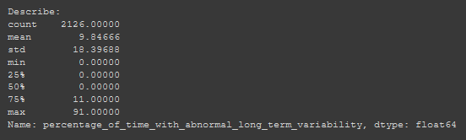
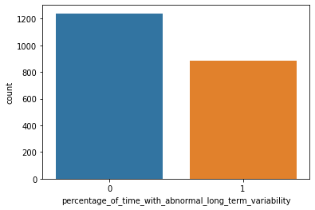

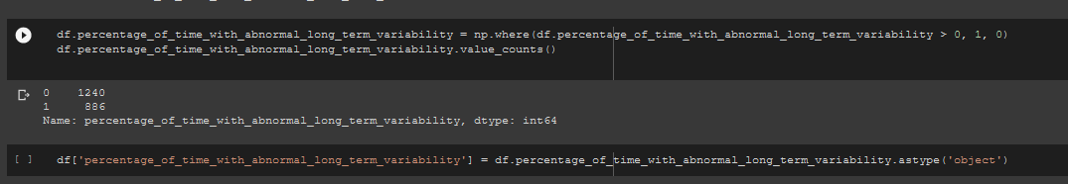
percentage_of_time_with_abnormal_long_term_variability
Countplot of prolongued_decelerations
Converted to categorical

Slide 13
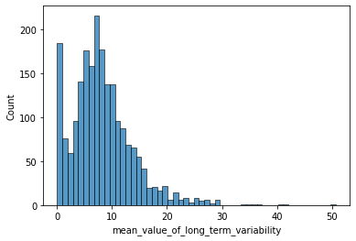
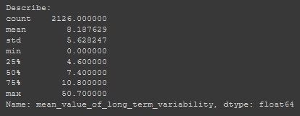
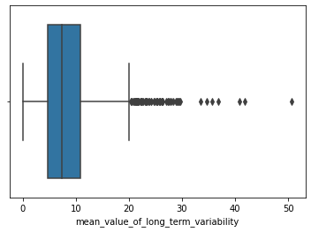


mean_value_of_long_term_variability
Histogram of mean_value_of_long_term_variability
Boxplot of mean_value_of_long_term_variability
Scatter plot of mean_value_of_long_term_variability
Outliers treatment

Slide 14





histogram_max
Histogram of mean_value_of_long_term_variability
Boxplot of mean_value_of_long_term_variability
Scatter plot of mean_value_of_long_term_variability
Outliers treatment

Slide 15





histogram_number_of_peaks
Histogram of histogram_number_of_peaks
Boxplot of histogram_number_of_peaks
Scatter plot of histogram_number_of_peaks
Outliers treatment

Slide 16





histogram_mode
Boxplot of histogram_mode
Histogram of histogram_mode
Scatter plot of histogram_mode
Outliers treatment

Slide 17





histogram_mean
Boxplot of histogram_mode
Histogram of histogram_mode
Scatter plot of histogram_mode
Outliers treatment

Slide 18





histogram_median
Boxplot of histogram_median
Histogram of histogram_median
Scatter plot of histogram_median
Outliers treatment

Slide 19





histogram_variance
Boxplot of histogram_variance
Histogram of histogram_variance
Scatter plot of histogram_variance
Outliers treatment

Slide 20




histogram_tendency
Countplot of histogram_tendency
Tukey HSD – Category Minimization
Converted to categorical

Slide 21


Heatmap(Correlation)

Slide 22






Model (Decision Tree)
Label Encoding
CCP_alpha = 0.038
*Accuracy on test dataset is 0.84

Slide 23






Model (random forest)
CCP_alpha = 0.038
*Accuracy on test dataset is 0.87

Slide 24




Model (Ada Boosting)
*Accuracy on test dataset is 0.90

Slide 25





Model (Gradient Boosting)
*Accuracy on test dataset is 0.8

Slide 26







PCA

Slide 27






Model (KNN)
*Accuracy on test dataset is 0.89

Slide 28





Model (SVM – Grid Search)
*Accuracy on test dataset is 0.91

Slide 29






Model (Naïve Bayes)
*Accuracy on test dataset is 0.80

Slide 30

Accuracy of all the Models

Slide 31

Thank You

